Slide 1
History and Development Leading to Jefferson National Laboratory
Very little detailed physics (suggested by PTB)
Trends of the field of electromagnetic probes
Role of Illinois
Role of Stanford
Role of Orsay
Role of Saclay
Role of Mainz
Role of NIKHEF
Role of Darmstadt
Role of Tohoku
Role of NBS
Role of Lebedev Institute
Role of MAX-lab
Role of Frascati
Role of BATES
Role of Theorists
Role of yours truly

Slide 2
Nuclei Nucleons Quarks and Photons
Featuring
William Bertozzi
And
A Cast of Major Characters Numbering
Thousands

Slide 3
How Did It Begin?
Rutherford, Geiger and Marsden – Centennial
Lyman-Hanson-Scott – U of Illinois circa 1951 Electron Scattering -15.7 MeV, radius of C, Al, Cu
Giant Dipole Resonance – NBS and many Betatron Labs
Stanford – Hofstadter – HEPL – SLAC - QUARKS
ILLINOIS, SACLAY, NIKHEF, BATES, MAINZ, DARMSTADT, YALE, RPI, LEBEDEV, FRASCATI, …….
1976 …..And the race to JLab was on……..

Slide 4
A CONTEST – Magnetrons vs Klystrons
HEPL - Varian – Lytton Klystrons
Amplifiers, Natural Phase Control- very high power.
MIT- J. C. Slater – Rad Lab – Magnetrons
Self Excited Oscillators-stimulated emission phase control - like a laser
Power limitations - Amplitrons
17 MeV electron accelerator (P.T.Demos)
21 magnetrons – 1.5 MeV Van de Graaff injector
1953 –Grad school MIT – Yours Truly

Slide 5
MIT – The Early Days
GDR – Why Collective Motion?
Sum Rule: Sum = .06(NZ/A)(1+x)
Photon interacts with a single proton and not a neutron
Best test: Measure neutron energy spectra
S.B. Thesis - Threshold detectors using (n,p) reactions - Y. Halpern advisor – Lots of high energy neutrons.
It was very hard to count during the one microsecond beam pulse. Hence threshold detectors and radioactivity.
Dave Brink in 1960’s put it all on a firm basis – Door-way states…feed GDR… SHO model
G. Brown – Development of a GDR – degeneracy etc. the 1, 3-, etc states follow from single particle transitions- collectivity as well from residual interactions

Slide 6
What Did the Linac at MIT Look Like? Movie
“The Ultimate Speed: An Experiment With High Energy Electrons”
William Bertozzi
Educational Development Corporation
Etc.
What to do about duty low duty ~2 x 10⁻⁴ ?
Develop a technique that uses low duty

Slide 7
Fast Neutron Time-of-Flight Spectroscopy
Fast beam pulse – 1.8 x 10⁻⁹ second duration
I did not know it was impossible in 1953
Studied (γ,n) spectra from heavies and many others
Deuteron
Noticed resonant absorption in Pb – neutron lines!!! Leads to Nuclear Resonance Fluorescence (50 years later … NRF at Passport Systems, Inc.)
Photo-Fission Where do prompt neutrons come from? Accelerated fragments – not scission- (50 years later … PNPF at Passport systems Inc.)
Many excellent students
Colleagues: Phil Sargent; Bill Turchinetz

Slide 8
Proposal for 150 MeV Accelerator
Purpose was fast photo-neutron time-of-flight spectroscopy
Many important studies to perform
Angular distributions
Polarization
Great reviews…..NO awards for an accelerator.
4 years… discover the same proposal is awarded to Oak Ridge and Livermore
Changed proposal to electron scattering….. 600 MeV Linac 2% duty…..1963-1964

Slide 9
In The Meantime
Work at RPI on Studies of photo-neutron polarization: Deuteron, Oxygen etc.
Start electron scattering from deformed nuclei at NBS (Sam Penner and Jim Leiss)
Used University of Saskatoon accelerator – Photo-protons…direct reaction study – n,p correlations????
Worked on design of 600 MeV accelerator for electron scattering at high resolution (10⁻⁴)
Rensselaer L-Band – Photo-neutron polarization
Deuteron, Oxygen GDR (d+s waves)
It is so hard to do counting experiments at low duty cycle accelerators !!!!!!!!!

Slide 10
EUREKA!!!!!
Very depressed with rotational nuclear studies at NBS– So much beam is thrown away for resolution. (1/1000)
On plane returning from experiments at NBS writing a note to director of LNS… let’s forget electron scattering …weak interaction…small cross sections… resolution of 10⁻⁴ means ~1/1000 of beam is used. Not a tool for general studies of nuclear structure…etc.
All of a sudden… why analyze incident beam like a Van de Graaff? All we need to know is ENERGY LOSS!!!!! Resolution in Q need not be as good and energy loss!
ENERGY LOSS SPECTROSCOPY!!!!
Now the note to the director was to change completely the design of the electron spectrometer and the beam transport system!

Slide 11
Award of Proposal
1966 award announced for 5M$ (Requested 8M$) (Same day and Andrea!!)
Reduced scope to one hall … energy to 400 MeV.
Then award reduced to 4.5M$ made other accommodations to keep one hall alive with E-Loss spectroscopy….machine design changed etc.
Where were you when we needed you Hermann Grunder??? (The only director I ever knew who could turn a budget cut into an increased budget!)

Slide 12
Energy Loss Spectrometer

Slide 13
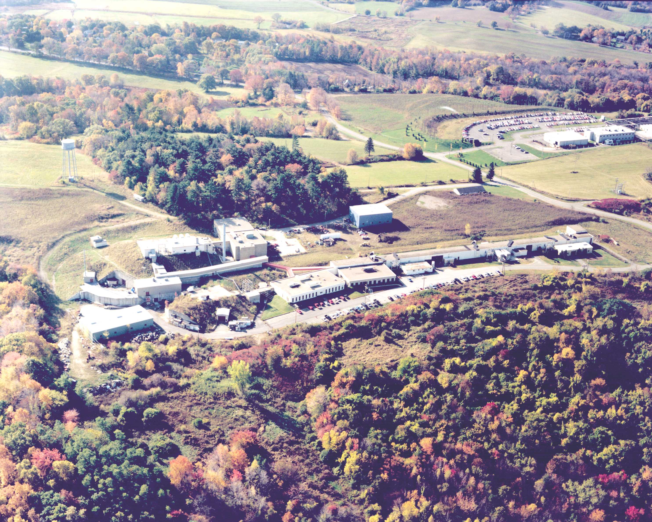
BATES Got Built
E-Loss system worked well 10⁻⁴ was routine resolution limited by targets and detectors.
Another development….Vertical Drift Chamber
Used at Jlab Hall A HRS spectrometers…
While Bates was under development we continued experiments at NBS and RPI and Saskatoon.

Slide 14
OHIPS

Slide 15
OOPS

Slide 16
BLAST on Storage Ring

Slide 17
Building Enthusiasm and Support
Summer study: Electron Linear Accelerators in Medium Energy Nuclear Physics, 1967..June-July-August
Covered many topics…Radiative corrections…correlations…coincidence studies for momentum distributions…etc.
Duty cycle was so very important
Bates was to be ~5% duty cycle…novel mod-anode klystrons and switch tubes…5,000pps rep rate etc. Components tested but system as a whole degraded ~2%.

Slide 18
The campaign for 100% duty cycle
Many great experiments were done at BATES and the other labs.
Experimental feasibility ran out at 1% duty for critical concepts. A factor of 100 is hard to beat by clever tricks.
Friedlander committee circa 1976… Recommends 2 GeV at 100% and approximately 140M$ ......
We are on the way!

Slide 19
A New Kid in Town
Jim McCarthy- He wants 4 GeV 100%
NSAC ~1982 Advises for a 4 GeV 100% duty accelerator for electromagnetic studies of strongly interacting systems.
SURA is organized… proposes for 4 GeV and 100% circular ring. (Jim McCarthy)
MIT proposes 2 GeV and a storage ring.
ARGONNE 4 GeV and a novel concept ring.
And the award goes to SURA
Hermann Grunder eventually becomes the Director to construct CEBAF

Slide 20
Yours Truly and Indiana Cyclotron
A new conjecture: For N=Z nuclei and ΔT=0 transitions the charge form factors are the same as matter form factors.
Makes electron scattering and hadron scattering have a “common ground.” “We can provide the model for the matter density and remove another uncertainty in studying the reaction mechanisms and two body T-matrix. Jim Kelly (deceased) showed the momentum dependence of the interactions.
Lonely black sheep.. He wanted 6-8 GeV

Slide 21
BIG DECISIONS
Grunder switches to cryogenics and recirculation
Christoph Leemann joins to build the cryogenic facility
Yours Truly joins to help build HRS in Hall A
Design and construct tracking vertical drift chambers…new stable electromagnetic design.

Slide 22
Pre-Construction

Slide 23
Hall C

Slide 24
JLab 2010

Slide 25
Upgrades
6 GeV a natural, simple not expensive part of system upgrade….thank you HG.
12 GeV … a more ambitious but very modest upgrade and very desirable.
JLAB
A facility for the next decades enabling fundamental research in the structure of Nucleons and Nuclei as strongly interacting systems.

Slide 26
The Future (Fill in the Blanks)
Energy: …………………
Electron-Ion collider: ………………….
Beam intensities: …………………
Polarizations: …………………….
100% duty is now standard.
Jlab is now the “world’s foremost facility” for probing cold, strongly interacting systems at short distances.
Let’s keep it that way.
I and my students plan to use it for a longtime to come .

Slide 27
TO JSA/SURA and JLAB Staff Students and Postdocs Colleagues DOE
A Marvelous Adventure
Thank You

